Slide 1
Principles of Compiler Design (SEng 3043)
Chapter Three
Syntax Analysis
Debremarkos Institute of Technology
School of Computing
Software Engineering Academic Program
By Lamesginew A. (lame2002@gmail.com )

Slide 2
Introduction: Syntax analysis
It is the second phase of compiler.
This phase is modeled through context free grammar (CFG).
The syntax analysis phase verifies that the string can be generated by the grammar for the source language.
It is also called parsing or hierarchical analysis.
The role of the parser
It obtains a string of tokens from the lexical analyzer.
It verifies that token names can be generated by the grammar for the source language.
The grammar that a parser implements is called a Context Free Grammar or CFG.
It reports syntax errors and recover from errors to continue processing the remainder of the program.
It constructs a parse tree and passes it to the rest of the compiler for further processing.
Figure: Position of parser in a compiler model
token
parse tree
intermediate representation
source program
Lexical Analyzer
Parser
Rest of Front End
get next
token
Symbol Table

Slide 3
Syntax Error Handling
programmers frequently write incorrect programs
a good compiler should assist the programmer in identifying and locating errors.
Common programming errors are the following.
Lexical errors
misspellings of identifiers, keywords , or operators
missing quotes around text intended as a string.
Syntactic errors
misplaced semicolons
extra or missing braces; that is , "{" or " }”
unbalanced parentheses
Semantic errors
Type mismatches between operators and operands.
An operator applied to an incompatible operand.
Logical errors
Use of = instead of = =
Use of * instead of /
Infinite recursive calls
Often much of the error detection and recovery in a compiler is centered on the syntax analysis phase (syntax errors).

Slide 4
,,, Cont’d
The error handler in a parser ( goals) :
It should report the presence of errors clearly and accurately.
It should recover from each error to be able to detect subsequent errors.
It should not significantly slow down the processing of correct programs.
How should an error handler report the presence of an error?
By reporting the place in the source program where an error is detected (line number)
It has to report also the type of error (if possible) for the detected errors.
Once an error is detected, how should the parser recover?
There is no strategy proven to be itself universally acceptable
There are four main error recovery strategies in error handling:
Panic-Mode Recovery: the parser discards input symbols one at a time until one of a designated set of synchronizing tokens is found.
Phrase-Level Recovery: a parser performs local correction on the remaining input that allows the parser to continue (e.g. replacing comma by semicolon, insert a missing semicolon).
Error Productions: enhance the grammar for the language with productions that generate the erroneous constructs.
Global Correction: Choosing minimal sequence of changes to obtain a globally least-cost correction.

Slide 5
Context-Free Grammars
It describes sets of strings (i.e. languages) and defines structure on these strings in the language it defines.
It is useful in specifying the syntactical structures of a programming language.
There are four components for a context free grammar.
Terminals
They are the basic symbols from which strings are formed.
Terminals is a finite set of tokens (terminal) symbols.
The term "token name" is a synonym for "terminal".
Non-Terminals
They are also called syntactic variables
They represent a set of strings of terminals, and they must be replaced by other things in a given grammar.
Non-terminals are used to specify strings.
Start symbol: taken from non-terminals to specify the language, and the rest are used for specifying the string.
Production rules: specify the manner in which the terminals and non-terminals can be combined to form strings.

Slide 6
Each production consists of:
A non-terminal called the head or left side of the production;
The symbol →
A body or right side consisting of zero or more terminals and non-terminals.
For conventional notations, the following symbols are terminals:
Lowercase letters like a, b, c
Operator symbols such as +, *, and so on
Punctuation symbols such as parentheses, comma, and so on
The digits 0, 1, ... ,9
Boldface strings such as id or if, each of which represents a single terminal symbol.
The following symbols are nonterminals:
Uppercase letters are A, B, C.
The letter S is usually the start symbol.
Unless stated otherwise, the head of the first production is the start symbol.
Set of productions with common head like A → α₁, A → α₂ , ... , A → α_{k} can be written as
A → α₁| α₂ | … | α_{k}.
Example: a CFG that generates equal number of a’s and b’s is
S → aSbS | bSaS | ε

Slide 7
Derivations
It is a sequence of production rules to get the input string.
It is a sequence of replacements of non-terminal symbols of the input string from the production rule.
Two decisions are made:
Deciding the non-terminal which is to be replaced.
Deciding the production rule, by which, the non-terminal will be replaced.
If there is a nonterminal A in a grammar symbol αAβ, and if there is production A → γ then, we can write αAβ → αγβ.
There are two kinds of derivations: LMD and RMD
Left - most Derivation (LMD)
the leftmost variable in a production body is replaced by one of its production bodies first.
In each derivation step, we choose the left-most non-terminal.
Right - most Derivation (RMD)
we scan and replace the input with production rules, from right to left.
we always choose the right-most non-terminal in each derivation step

Slide 8
,,,Cont’d
Consider the input string id + id * id, and productions
E → E + E | E * E | id
Then derive the string using LMD and RMD?
Using left most derivation (LMD), it will be the following.
E → E * E
E → E + E * E
E → id + E * E
E → id + id * E
E → id + id * id
Notice that the left-most side non-terminal (underlined one) is always processed first.
Using right most derivation (RMD), it will be the following.
E → E + E
E → E + E * E
E → E + E * id
E → E + id * id
E → id + id * id

Slide 9
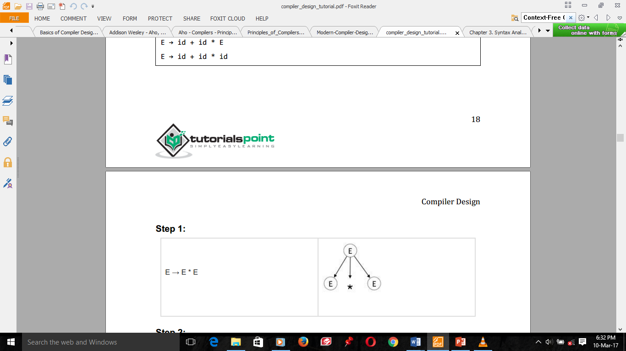
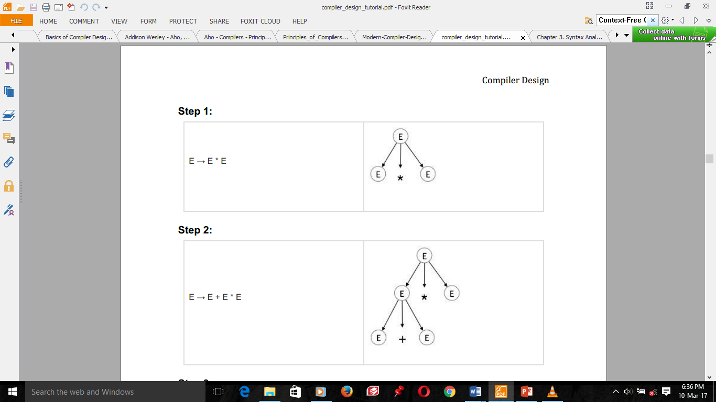
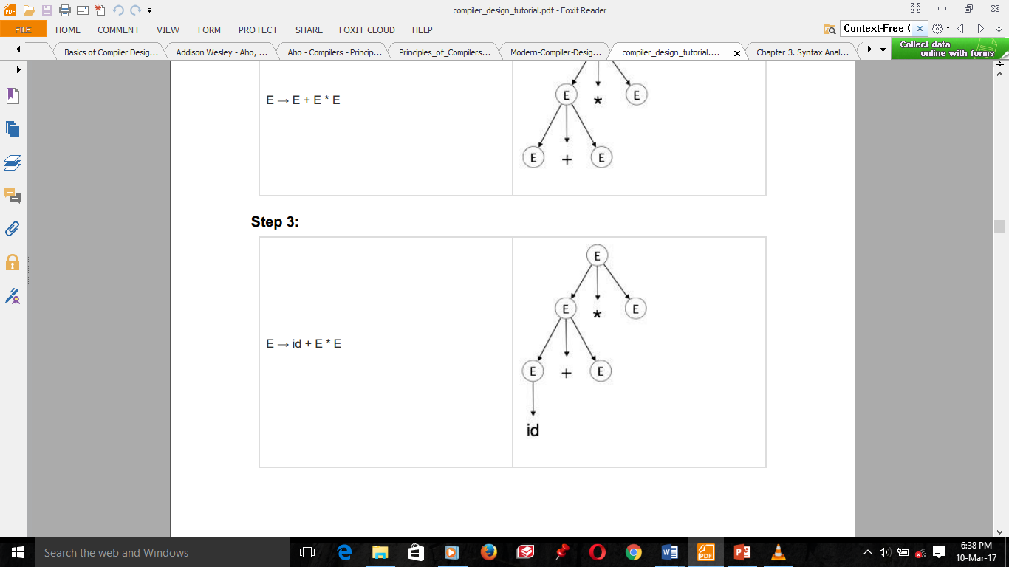
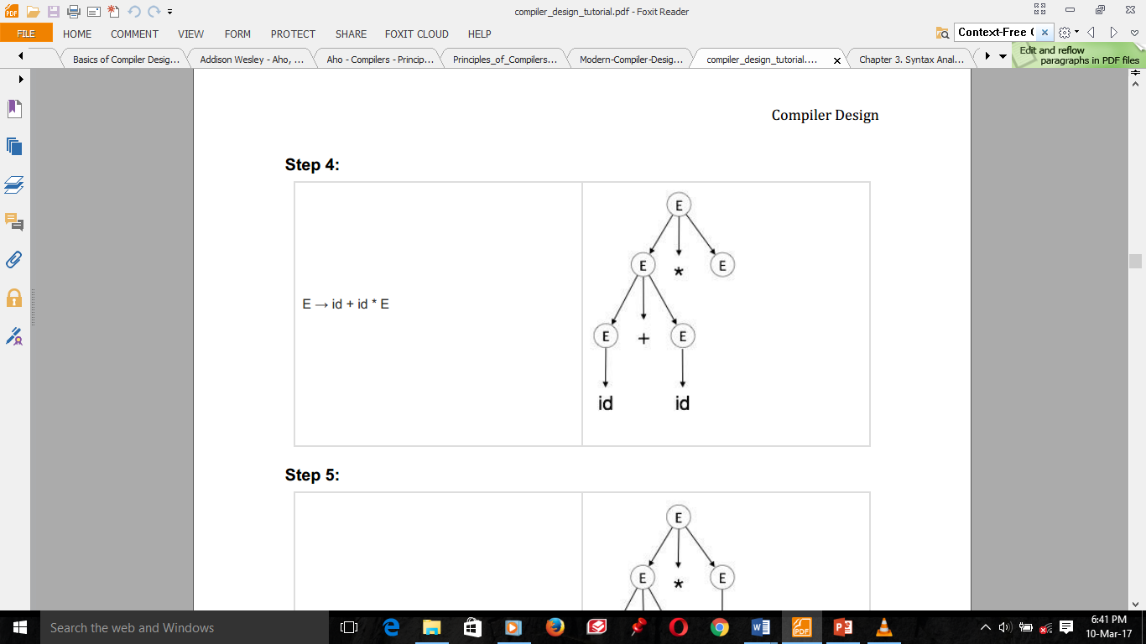
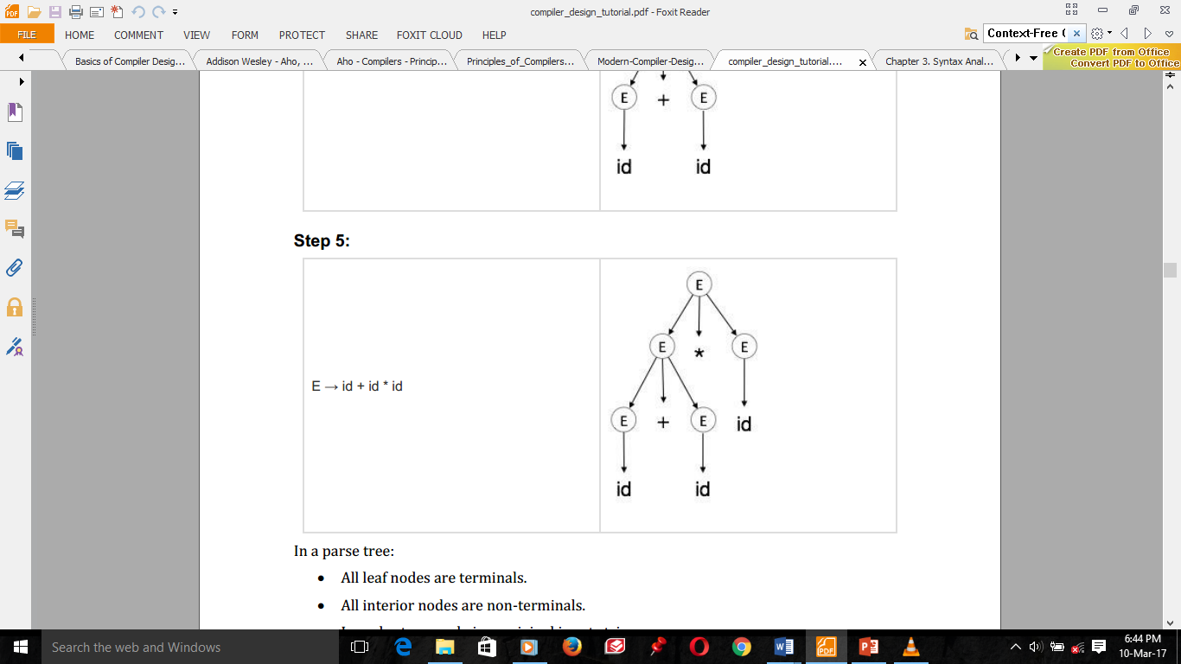
Derivation and parse tree
A parse tree is a graphical depiction of a derivation.
The start symbol of the derivation becomes the root of the parse tree.
Construction of the parse tree for the above LMD is the following.
Step 1: | E → E * E
Step 2: | E → E + E * E
Step 3: | E → id + E * E
Step 4: | E → id + id * E
Step 5: | E → id + id * id

Slide 10
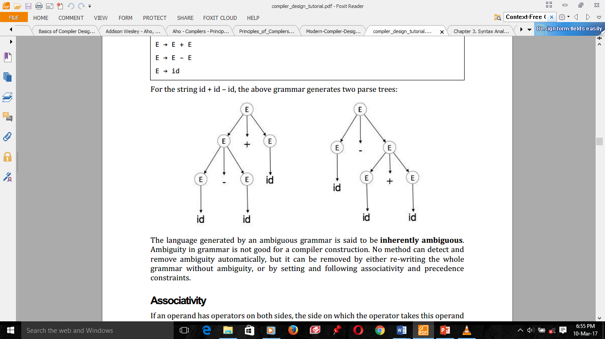
,,,Cont’d
a parse tree pictorially shows how the start symbol of a grammar derives a string in the language.
In a parse tree:
The root of the tree is the start symbol
All leaf nodes are terminals
All interior nodes are non-terminals
In-order traversal gives original input string
Ambiguity
A grammar G is said to be ambiguous if it has more than one parse tree for one string.
Example: consider the input string id-id+id and the production.
E → E + E
E → E – E
E → id
using LMD using RMD

Slide 11
Context-Free Grammars Versus Regular Expressions
Grammars are a more powerful notation than regular expressions.
Every construct that can be described by a regular expression can be described by a grammar, but not vice-versa.
Alternatively, every regular language is a context-free language, but not vice-versa.
For example, the regular expression (a|b)*abb and the grammar
A₀ → a A₀ | bA₀ | a A₁
A₁ → bA₂
A₂ → bA₃
A₃ → ε
describe the same language, the set of strings of a's and b's ending in abb.
The language L = {a^{n}b^{n} | n ≥ 1) with equal number of a's and b's can be described by a grammar but not by a regular expression.
Regular expressions are most useful for describing the structure of lexical constructs such as identifiers, constants, keywords etc.
Grammars are most useful in describing nested structures such as balanced parentheses, matching begin-end’s, etc

Slide 12
Group Assignment-1 (10%)
Write a context free grammar used to describe the language L = {a^{n}b^{n} | n ≥ 1) with equal number of a's and b's.

Slide 13
1. Top - Down Parsing

Slide 14
Introduction
A Top-down parser tries to create a parse tree from the root towards the leafs scanning input from left to right.
It creates the nodes of the parse tree in preorder (depth-first): the top of a subtree is constructed before any of its lower nodes.
It can be also viewed as finding a leftmost derivation for an input string
Example: id+id*id
E → TE’
E’ → +TE’ | Ɛ
T → FT’
T’ → *FT’ | Ɛ
F → (E) | id

Slide 15
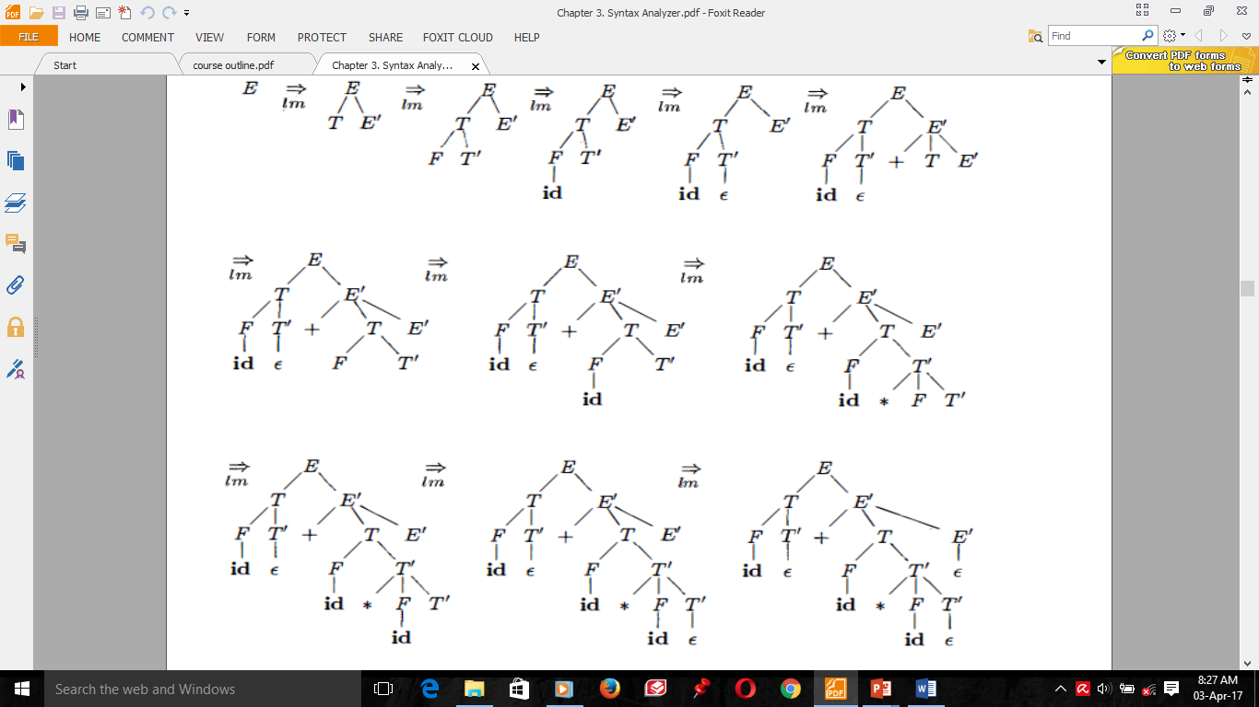
Top-down parse for id + id * id

Slide 16
Recursive descent parsing
It is a top-down parsing technique, constructs the parse tree from the top.
It uses procedures for every terminal and nonterminal entity.
This parsing technique recursively parses the input to make a parse tree.
It may or may not require backtracking (If a choice of a production rule does not work, we backtrack to try other alternatives.)
Procedure to construct the parse tree using recursive-descent parsing:
We create one node tree consisting of S.
Two pointers, one for the tree and one for the input, will be used to indicate where the parsing process is. Initially, they will be on S and the first input symbol, respectively.
Then we use the first S-production to expand the tree. The tree pointer will be positioned on the leftmost symbol of the newly created sub-tree.
As the symbol pointed by the tree pointer matches that of the symbol pointed by the input pointer, both pointers are moved to the right.
Whenever the tree pointer points on a non-terminal, we expand it using the first production of the non-terminal.
Whenever the pointers point on different terminals, the production that was used is not correct, thus another production should be used. We have to go back to the step just before we replaced the non-terminal and use another production.
If we reach the end of the input and the tree pointer passes the last symbol of the tree, we have finished parsing.

Slide 17
S
S
S
Example:
S → cAd
A → ab | a
Input (w): cad
c
A
d
c
A
d
c
A
d
a
a
b
Fig (a)
Fig (c)
Fig (b)
Begin with a tree consisting of a single node of S, and the input pointer pointing to c.
S has only one production, so we use it to expand S and obtain the tree of Fig. (a).
The leftmost leaf, labeled c, matches the first symbol of input, so we advance the input pointer to a, and consider the next leaf, labeled A.
Now, expand A using the first alternative A → a b to obtain the tree of Fig.(b).
We have a match for the second input symbol, a, so we advance the input pointer to d, and compare d against the next leaf, labeled b.
Since b does not match d, go back to A to see another alternative for A that has not been tried, but that might produce a match.
In going back to A, reset the input pointer to position 2, the position it had when we first came to A.
The second alternative for A produces the tree of Fig. (c). The leaf a matches the second symbol and the leaf d matches the third symbol.
Since we have produced a parse tree for w, we halt and announce successful completion of parsing.

Slide 18
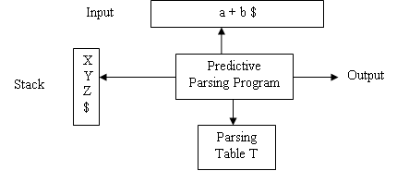
Predictive Parsing
Also called non-Recursive Predictive Parser (or) Table Driven Predictive Parser.
It is a top-down parsing that can be built by maintaining a stack explicitly, rather implicitly via recursive calls.
It is a special form of recursive descent parsing without backtracking.
To make the parser back-tracking free, it accepts only LL(1) grammars.
It needs the following components to check whether the given string is successfully parsed or not.

Slide 19
The input buffer contains the string to be parsed followed by $ (right end marker). This is used to indicate that the input string is terminated.
The stack contains a sequence of grammar symbols (non-terminals or terminals).
Initially the stack is pushed with “$” on the top of the stack.
After that, as parsing progresses the grammar symbols are pushed.
This “$” is used to announce the completion of parsing.
The parsing table is generally a two dimensional array. An entry in the table is referred T[A, a], where ‘A’ is a non-terminal (row), ‘a’ is a terminal or the symbol ‘$’ (column) and ‘T’ is a Table name. Each entry holds a production rule.
The parsing routine (output) works in conjunction with the parsing table. The output is a production rule representing a step of the derivation sequence of the string in the input buffer.

Slide 20
First and Follow
They are used in the construction of both top-down and bottom-up parsers.
They allow us to choose which production to apply during top-down parsing.
Sets of tokens produced by FOLLOW can be used as synchronizing tokens during panic mode error recovery.
They allow us to fill in the entries of a predictive parsing table.
FIRST (X) is the set of terminals that appear as the first symbols of one or more strings generated from a grammar symbol. It is the set of terminals that begin all strings derived from X.
FOLLOW (A), for any nonterminal A, is set of terminals that can appear immediately after A in some sentential form.

Slide 21
Computing First
To compute FIRST(X) for all grammar symbols X, apply the following rules until no more terminals or ɛ can be added to any FIRST set.
If X is a terminal, then FIRST(X) is X itself. Example: First(id)={id}.
If X is a non-terminal and X →Y₁Y₂ . . . Y_{k} is a production for some k ≥ 1, add all non- ɛ symbols of FIRST(Y₁) in FIRST (X).
If X is a non-terminal and X →Y₁Y₂ . . . Y_{k} is a production for some k ≥ 1, add the non-ɛ symbols of FIRST(Y₂) if ɛ is in FIRST(Y₁); the non-ɛ symbols of FIRST(Y₃) if ɛ is in FIRST(Y₁) and FIRST(Y₂); and so on in FIRST (X).
If X is a non-terminal and X →Y₁Y₂ . . . Y_{k} is a production for some k ≥ 1, and if, for all i, ɛ is in FIRST(Y_{i}), then add ɛ in FIRST (X)
If there is a production X →Y then FIRST(X)=FIRST(Y).
If X → ɛ is a production then add ɛ to FIRST(X)
Computing Follow
To compute FOLLOW (A) for all nonterminals A, apply following rules until nothing can be added to any follow set:
Place $ in FOLLOW(S) where S is the start symbol
If there is a production A → αBβ then everything in FIRST(β) except ɛ is in FOLLOW(B).
If there is a production A → B or a production A →αBβ where FIRST(β) contains ɛ, then everything in FOLLOW(A) is in FOLLOW(B).

Slide 22
Example: First and Follow
Consider the following non-left-recursive grammar:
E → TE'
E' → +TE' | ɛ
T → FT'
T' → *FT' | ɛ
F → (E) | id
FIRST(F) = {(,id}
FIRST(T’) = {*, ɛ}
FIRST(T) = {(,id}
FIRST(E’) = {+, ɛ}
FIRST(E) = {(,id}
FIRST(TE’) = {(,id}
FIRST(+TE’) = {+}
FIRST(ɛ) = {ɛ}
FIRST(FT’) = {(,id}
FIRST(*FT’) = {*}
FIRST((E)) = {(}
FIRST(id) = {id}
FOLLOW(E) = { $, ) }
FOLLOW(E’) = { $, ) }
FOLLOW(T) = { +, ), $ }
FOLLOW(T’) = { +, ), $ }
FOLLOW(F) = {+, *, ), $ }

Slide 23
Construction of Predictive parsing table
Predictive parsing table is generally a two dimensional array.
It has rows as non-terminals and columns as terminals, the symbol ‘$’ is used as the last column.
In a predictive parsing table T[A, a], A is a nonterminal, and a is a terminal or the symbol $, the input end marker.
In constructing a predictive parsing table, for each production A → X then do the following steps. (X is a grammar symbol).
For each terminal a in FIRST(X), add A → X to T[A, a].
If FIRST(X) has ɛ, then for each terminal b in FOLLOW(A), add A → X to T[A, b].
If FIRST(X) has ɛ and $ is in FOLLOW(A), then add A → X to T[A, $].

Slide 24
Example: Constructing predictive parsing table
Consider the previous grammar
E → TE'
E' → +TE' | ɛ
T → FT'
T' → *FT' | ɛ
F → (E) | id
Non-terminals | First | Follow
F | {(, id} | {+, *, ), $}
T | {(, id} | {+, ), $}
E | {(, id} | {), $}
E’ | {+, ɛ} | {), $}
T’ | {*, ɛ} | {+, ), $}
The predictive parsing table is the following.
Non-terminals | Input Symbols
 | id | + | * | ( | ) | $
E | E → TE’ |  |  | E → TE’
E’ |  | E’ → +TE’ |  |  | E’ → Ɛ | E’ → Ɛ
T | T → FT’ |  |  | T → FT’
T’ |  | T’ → Ɛ | T’ → *FT’ |  | T’ → Ɛ | T’ → Ɛ
F | F → id |  |  | F → (E)
Consider E → TE'. Since FIRST(TE') = FIRST(T) = { (, id } this production is added to T[E, (] & T[E, id].
Production E' → +TE' is added to T[E', +] since FIRST (+TE') = {+}.
Since FOLLOW(E') = { ), $ }, production E' → Ɛ is added to T[E', )] and T[E', $) .

Slide 25
LL(1) Grammars
Predictive parsers are those recursive descent parsers needing no backtracking.
Grammars for which we can create predictive parsers are called LL(1)
The first L means scanning input from left to right
The second L means leftmost derivation
And 1 stands for using one input symbol for lookahead
It is a grammar whose parsing table has no multiply-defined entries.
The parsing table of a grammar may contain more than one production rule. In this case, we say that it is not a LL(1) grammar .
A grammar G is LL(1) if and only if whenever A→ α| β are two distinct productions of G, the following conditions hold:
For no terminal a do α and β both derive strings beginning with a. That is, both αand β cannot derive strings starting with same terminals.
At most one of αor β can derive empty string.
If α => ɛ in zero or more steps then β does not derive any string beginning with a terminal in Follow(A). Likewise, if β => ɛ in zero or more steps, then α does not derive any string beginning with a terminal in FOLLOW(A).
The first two conditions states that FIRST(α) and FIRST(β) are disjoint sets.
The third condition states that if ɛ is in FIRST(β), then FIRST(α) and FOLLOW(A) are disjoint sets, and likewise if ɛ is in FIRST(α).

Slide 26
Example: LL(1) Grammar
Example: Let a grammar G be given by:
S → iEtSS' | a
S' → eS | ɛ
E → b
Is the grammar G a LL(1) grammar?
Non-terminal | Input Symbols
 | a | b | e | i | t | $
S | S → a |  |  | S → iEtSS’
S’ |  |  | S’ → Ɛ S’ → eS |  |  | S’ → Ɛ
E |  | E → b
From this parsing table, the entry for T[S', e] contains both S' → eS and S' → Ɛ.
The grammar is ambiguous and the ambiguity is manifested by a choice in what production to use when an e is seen.
Hence the grammar is not LL(1) grammar.

Slide 27
2. Bottom - Up Parsing

Slide 28
Introduction
It Constructs parse tree for an input string beginning at the leaves (the bottom) and working towards the root (the top).
It constructs the nodes in the parse tree in postorder: the top of a subtree is constructed after all of its lower nodes have been constructed.
Here, we start from a sentence and then apply production rules in reverse manner in order to reach the start symbol.
If the start symbol of the grammar can be obtained, from the input string, then the string is said to be accepted by the language.
The input string is reduced by the given productions of the grammar so that the start symbol is obtained.
Bottom-up parsers attempt to find the right–most derivation in reverse for given input string.

Slide 29
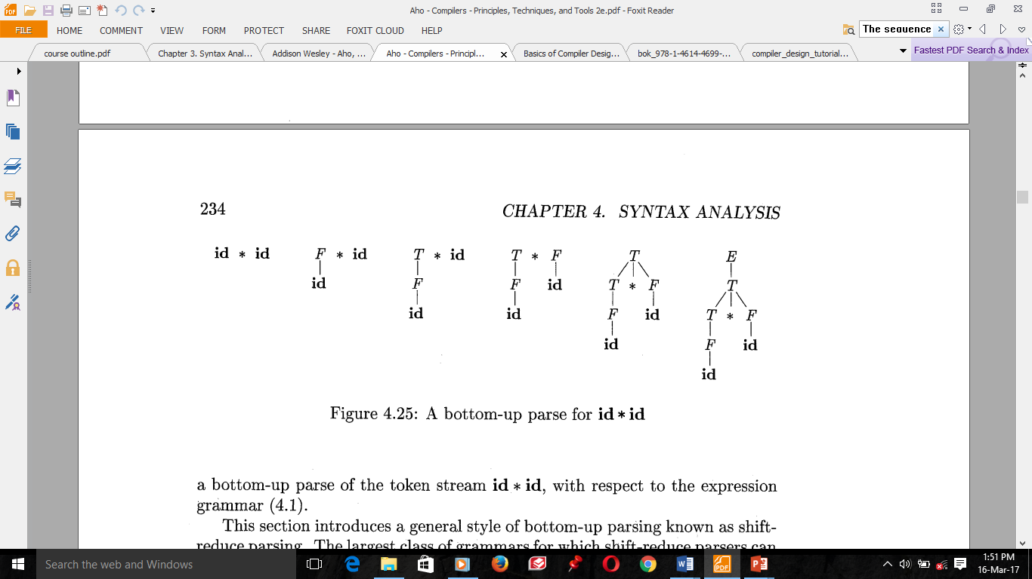
Example: Bottom – up Parsing
Example:
The sequence of tree snapshots in the following figure illustrates a bottom-up parse of the token stream id * id, with respect to the expression of the following grammar.
E → E + T | T
T → T * F | F
F → (E) | id

Slide 30
Example: Bottom – up Parsing
Example: consider the grammar
S → aABe
A → Abc|b
B → d
Given the input string abbcde.
Using bottom-up parsing, the acceptance is as shown below.
abbcde
aAbcde [A → b]
aAde [A → Abc]
aABe [B → d]
S [S → aABe]
Thus the start symbol ‘S’ is obtained, which shows the acceptance of the string abbcde by G.
This is the reverse of the right most derivation
The rightmost derivation for the same is the following
S→ aABe
→aAde
→aAbcde
→abbcde

Slide 31
Reductions
bottom-up parsing is the process of "reducing" a string to the start symbol of the G.
At each reduction step, a particular substring matching the body of a production is replaced by the symbol of the left of that production (head), and if the substring is chosen correctly at each step, a rightmost derivation is traced out in reverse.
The key decisions during bottom-up parsing are about when to reduce and about what production to apply, as the parse proceeds.
The reductions for the previous bottom-up parsing produces the following sequence of strings.
id * id , F * id, T * id, T * F, T, E
The strings in this sequence are formed from the roots of all the subtrees in the snapshots.
A reduction is the reverse of a step in a derivation (recall that in a derivation, a nonterminal in a sentential form is replaced by the body of one of its productions).
The goal of bottom-up parsing is therefore to construct a derivation in reverse.
The following derivation corresponds to the previous parsing:
E ⇨ T ⇨ T * F ⇨ T * id ⇨ F * id ⇨ id * id
This derivation is in fact a rightmost derivation.

Slide 32
Shift-Reduce Parsing
Shift-reduce parsing is a form of bottom-up parsing in which a stack holds grammar symbols and an input buffer holds the rest of the string to be parsed.
A shift-reduce parser tries to reduce the given input string into the starting symbol.
A string ---------------------------→ the starting symbol
reduced to
The general idea is to shift some symbols of input to the stack until a reduction can be applied
A stack is used to hold grammar symbols
Handle always appear on top of the stack
Initial configuration (w is input string)
Stack Input
$ w$
Acceptance configuration
Stack Input
$S $

Slide 33
Example: Shift-Reduce Parsing
There are four possible actions a shift-reduce parser can make.
Shift. Shift the next input symbol on the top of the stack.
Reduce. The right end of the string to be reduced must be at the top of the stack. Locate the left end of the string within the stack and decide with what nonterminal to replace the string.
Accept. Announce successful completion of parsing.
Error. Discover a syntax error and call an error recovery routine.
The following table shows the steps through the actions a shift-reduce parser might take in parsing input string id₁*id₂ over the previous expression grammar.
Stack | Input | Action
$ | id₁*id₂ $ | shift
$ id₁ | *id₂ $ | reduce by F → id
$ F | *id₂ $ | reduce by T →F
$ T | *id₂ $ | shift
$ T* | id₂ $ | shift
$ T*id₂ | $ | reduce by F → id
$ T*F | $ | reduce by T →T*F
$ T | $ | reduce by E →T
$ E | $ | accept

Slide 34
Introduction to LR Parsing
The most prevalent type of bottom-up parsers.
LR(k), mostly interested on parsers with k<=1; When k is omitted, k is assumed to be 1.
Where
“L” is for left-to-right scanning of the input,
“R” for constructing a rightmost derivation in reverse,
k for the number of input symbols of look ahead that are used in making parsing decisions.

Slide 35
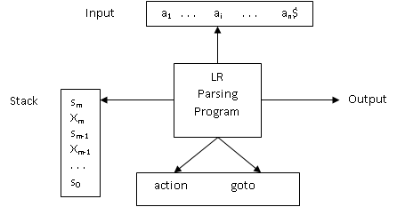
Model of LR Parsing
The parsing program reads characters from an input buffer one at a time.
The program uses a stack to store a string of the form s₀X₁s₁X₂ . . . X_{m}s_{m}, where s_{m} is on top
Each X_{i} is a grammar symbol and each s_{i} is a symbol called a state.
Each state symbol summarizes the information contained in the stack below it, and the combination of the state symbol on top of the stack and the current input symbol are used to index the parsing table and determine the shift-reduce parsing decision

Slide 36
Model of LR Parsing
The parsing table consists of two parts: a parsing-action function action and a goto function goto.
It determines s_{m}, the state currently on top of the stack, and a_{i}, the current input symbol
It then consults action[s_{m}, a_{i}], the parsing action table entry for state s_{m} and input a_{i}, which can have one of four values:
shift s, where s is a state,
reduce by a grammar production A→β,
accept, and
error

Slide 37
LR Parsing Algorithm
let a be the first symbol of w$;
while(true) { /*repeat forever */
let s be the state on top of the stack;
if (ACTION[s, a] = shift t) {
push a onto the stack;
push t onto the stack;
let a be the next input symbol;
} else if (ACTION[s, a] = reduce A→β) {
pop 2*|β| symbols of the stack;
let state t now be on top of the stack;
push A onto the stack;
push GOTO[t, A] onto the stack;
output the production A→β;
} else if (ACTION[s, a]=accept) break; /* parsing is done */
else call error-recovery routine;
}

Slide 38
LR Parsing Algorithm
The configurations resulting after each of the four types of move are as follows:
If action[s_{m}, a_{i}] = shift s, the parser executes a shift move. Here the parser has shifted both the current input symbol a_{i} and the next state s, which is given in action[s_{m}, a_{i}], onto the stack; a_{i+1} become the current input symbol.
If action[s_{m}, a_{i}] = reduce A → β, then the parser executes a reduce move. Here the parser first popped 2r symbols off the stack (r state symbols and r grammar symbols), exposing state s_{m-r}. The parser then pushed both A, the left side of the production, and s, the entry for goto[s_{m-r}, A], onto the stack. (r is the length of β, the right side of the production). The current input symbol is not changed.
If action[s_{m}, a_{i}] = accept, parsing is completed.
If action[s_{m}, a_{i}] = error, the parser has discovered an error and call an error recovery routine.

Slide 39
Example: LR Parsing Algorithm
Example:
State | action |  |  |  |  |  | goto
 | id | + | * | ( | ) | $ | E | T | F
0 | s5 |  |  | s4 |  |  | 1 | 2 | 3
1 |  | s6 |  |  |  | acc
2 |  | r2 | s7 |  | r2 | r2
3 |  | r4 | r4 |  | r4 | r4
4 | s5 |  |  | s4 |  |  | 8 | 2 | 3
5 |  | r6 | r6 |  | r6 | r6
6 | s5 |  |  | s4 |  |  |  | 9 | 3
7 | s5 |  |  | s4 |  |  |  |  | 10
8 |  | s6 |  |  | s11
9 |  | r1 | s7 |  | r1 | r1
10 |  | r3 | r3 |  | r3 | r3
11 |  | r5 | r5 |  | r5 | r5
(1) E → E + T
(2) E→ T
(3) T → T * F
(4) T→ F
(5) F → (E)
(6) F→ id
id*id+id?
si means shift and push to stack state i,
rj means reduce by a production numbered j,
acc means accept
blank means error

Slide 40
Example: LR Parsing Algorithm
On input id*id+id, the sequence of stack and input contents is shown in the following.
Line | Stack | Symbols | Input | Action
(1) | 0 |  | id*id+id$ | Shift to 5
(2) | 05 | id | *id+id$ | Reduce by F→id
(3) | 03 | F | *id+id$ | Reduce by T→F
(4) | 02 | T | *id+id$ | Shift to 7
(5) | 027 | T* | id+id$ | Shift to 5
(6) | 0275 | T*id | +id$ | Reduce by F→id
(7) | 02710 | T*F | +id$ | Reduce by T→T*F
(8) | 02 | T | +id$ | Reduce by E→T
(9) | 01 | E | +id$ | Shift
(10) | 016 | E+ | id$ | Shift
(11) | 0165 | E+id | $ | Reduce by F→id
(12) | 0163 | E+F | $ | Reduce by T→F
(13) | 0169 | E+T` | $ | Reduce by E→E+T
(14) | 01 | E | $ | accept

Slide 41
Reading assignment:
Read how SLR parsing table is constructed.

Slide 42
THANK YOU
VERY
MUCH !!

